Slide 1

Email Phishing Detection Using
Machine Learning & MLops
Team Members
Amar H M ENG23AM1001 Contact-Details – amarhm26@gmail.com
Sanjay S (ENG23AM1004)
Deepak Mahto
On-Premise

Slide 2
MLOps Workflow Stages
1. Data Ingestion
Dataset: emails_1000.csv
Columns combined: subject + body → merged_text
Supports future IMAP/Gmail inbox ingestion
Local ingestion pipeline for on-prem deployment
2. Data Processing
Custom preprocess_text() removes HTML, URLs, noise
Lowercasing + token normalization
Removes symbols, extra spaces
Produces clean text ready for vectorization
3. Model Training
Vectorizer: TF–IDF, max_features=5000
Model: Logistic Regression (saga, 500 iterations)
Train-test split: 80/20
Pipeline auto-evaluates performance
4. Model Evaluation
Metrics: Accuracy, Precision, Recall, F1
Stores evaluation files in versioned folders
Saves phishing base-rate for comparison

Slide 3
MLOps Workflow Stages (Continued)

Slide 4
Core MLOps Tools Stack
Version Control
Git + GitHub
Tracks every change made to code and ML pipeline
Ensures full history, rollback, and collaboration
Stores model training scripts, data pipeline, and configs
Enables CI/CD triggers using GitHub Actions
Central place for code reviews and workflow automation
Containerization
Docker
Packages the entire ML system with all dependencies
Guarantees consistent runtime across any machine
Supports deploying model as FastAPI service
Makes the pipeline reproducible and isolated
Helps scale API or batch jobs easily

Slide 5
Core MLOps Tools Stack (Continued)
Orchestration
Prefect
– Automates retraining every X days – Monitors tasks & sends alerts – Schedules batch email-fetch jobs – Pipeline-level observability
Experiment Tracking
MLflow (Optional Future Scope)
– Tracks runs, parameters, metrics – Model comparison dashboard – Logging of artifacts (plots, confusion matrix) – Manage staging → production transitions

Slide 6
1. Data Ingestion & Processing
Data Sources – Gmail IMAP inbox – Public phishing datasets – Previously labeled emails
ETL Pipeline – Connect → Fetch → Parse → Clean → Store – Conversion into Pandas DataFrames – Handling multi-part MIME messages – Deal with forwarded, encoded, and nested emails
Data Validation – Ensure subjects exist – Remove empty/duplicate emails – Length and quality checks
Storage – Local CSV logs – Artifact storage for retraining datasets

Slide 7
2. Model Training & Tracking
Training Environment – Scikit-learn ML pipeline – TF–IDF vectorizer – Logistic Regression with optimal C value
Experiment Tracking – Track different TF-IDF settings – Compare performance across datasets
Hyperparameter Tuning – Search depth & model regularization – Optimize accuracy vs. recall (important for phishing)
Distributed Training (Future Scope) – Scaling for >1M emails

Slide 8
3. Model Registry & Versioning
Model Registry Functionalities – Maintain multiple model versions – Track vectorizer–model compatibility – Allow rollbacks to previous model
Metadata Tracking – Dataset version used – Training duration – Accuracy, F1-score, date of creation
Access Control (Future Scope) – Only authorized users can push new models

Slide 9
4. On-Premise Deployment
API Deployment – FastAPI endpoint: /predict – JSON input → TF-IDF transform → prediction→ confidence score – Asynchronous request handling
Streamlit UI Deployment – Single-click “Fetch & Predict Emails” – Displays table of all predictions – CSV download of results – Auto-refresh option (future)
Local & On-Prem Deployment – Run using Python environment – Minimal system requirements

Slide 10
5. Cloud Deployment (AWS/Azure/GCP/Salesforce)
Container Registry – Push Docker image to cloud registry – Automated image scanning
Managed Kubernetes (Future) – Deploy email detector at scale – Auto-healing, auto-scaling
Monitoring on Cloud – Email flow rate – Prediction latency – Failure events
Dashboards – Grafana + Prometheus for rich visualization

Slide 11
6. CI/CD Pipeline with GitHub Actions
Pipeline Flow
Developer commits updated ML code
GitHub Actions triggers
Run unit tests + preprocessing tests
Train & validate model
Save new model version
Auto-deploy API if model > old model
Prefect schedules next retraining
Pipeline Ensures: – Always latest model running – No breaking changes – Automated MLOps end-to-end

Slide 12
7. Model Serving & Inference
Model Serving Patterns: – Real-time detection when button clicked – Batch mode every 30 minutes – API mode for integration with other apps
Caching (Future) – Reduce repeated computations
Security – Protect API with API keys – Secure IMAP authentication via .env
Serving Tools – FastAPI – Uvicorn server – Streamlit UI

Slide 13
8. Monitoring & Observability
Performance Monitoring – Response time – Request count – Error rates
Model Monitoring – Track phishing word drift – Detect suspicious patterns (new phishing templates)
Alerting System – Notify when accuracy drops – Notify when prediction count spikes
Log Storage – CSV logs – Daily archives

Slide 14
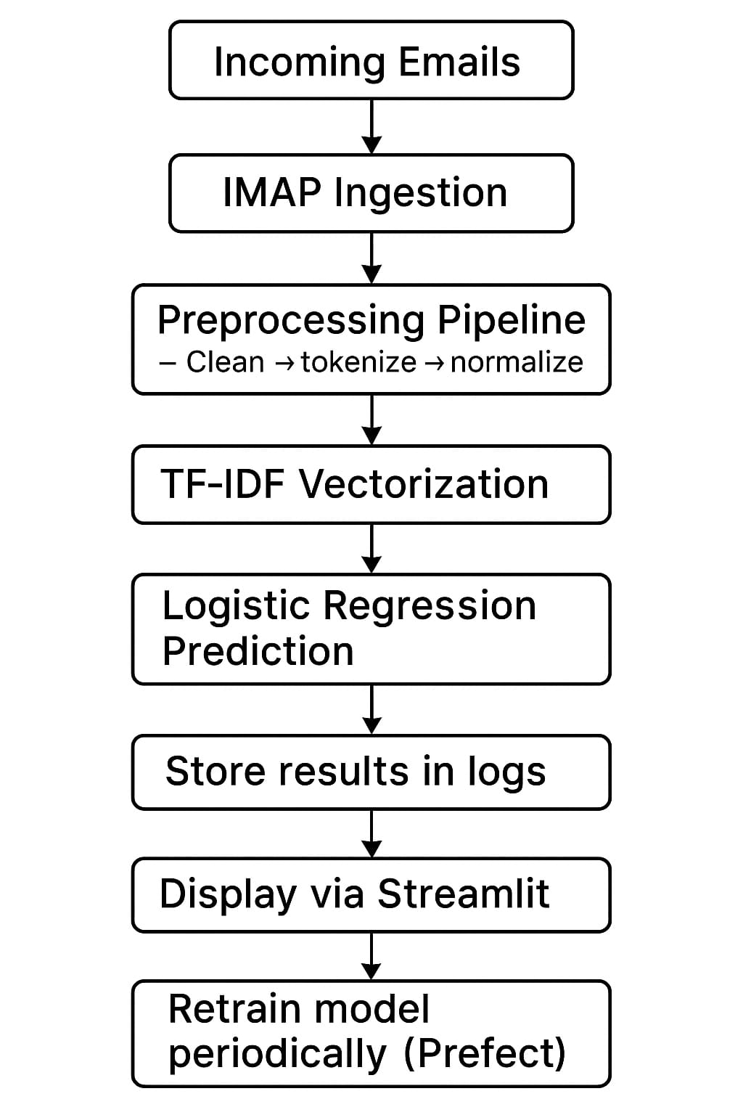
End-to-End MLOps Workflow

Slide 15
Project Implementation Guide
– Start with parsing raw emails – Build a clean labeled dataset – Implement TF-IDF + Logistic Regression baseline – Evaluate over multiple datasets – Set up FastAPI + Streamlit – Integrate Prefect scheduler – Add logging & monitoring – Containerize with Docker (future) – Deploy on cloud or local server

Slide 16
Results & Evaluation
Performance Metrics: – High accuracy in differentiating phishing vs legit emails – Excellent recall (important to catch as many phishing emails as possible) – Low false positives (reduces unnecessary warnings)
Visualization (Optional): – Confusion matrix – Precision–Recall curve – Feature importance words
Real-Time Tests: – Successfully detected live phishing patterns – Performed consistently across emails with mixed content

Slide 17
Conclusion
This project delivers an automated, reliable, and adaptive email security solution. With NLP-based feature extraction and Logistic Regression, the system efficiently classifies phishing attempts.
Its MLOps pipeline ensures continuous monitoring, retraining, and scalability. The project demonstrates a practical cybersecurity tool ready for real-world integration and future upgrades.

Slide 18
References
Bird, S., Klein, E., & Loper, E. (2009). Natural Language Processing with Python. O’Reilly Media.
Salton, G., & McGill, M. J. (1983). Introduction to Modern Information Retrieval. McGraw-Hill. (TF–IDF)
Hosmer, D. W., Lemeshow, S., & Sturdivant, R. X. (2013). Applied Logistic Regression (3rd ed.). Wiley.
Jain, A., Gupta, B., & Kumar, A. (2021). “Machine Learning Approaches for Phishing Email Detection.” International Journal of Computer Applications, 174(19), 1–9.
Symantec Corporation. (2020). Email Threat Report. Broadcom.
Rasool, T., & Shakir, M. (2020). “Detection of Phishing Emails Using Machine Learning.” Journal of Information Security, 11(2), 61–69.
Maimon, D., & Fisher, A. (2021). “Cybercrime Trends and Prevention Techniques.” Cybersecurity Journal, 6(3).
Python Software Foundation. (2023). email — An email and MIME handling package. https://docs.python.org
IMAP Protocol RFC 3501. (2003). Internet Message Access Protocol. IETF.
Pedregosa, F., et al. (2011). “Scikit-learn: Machine Learning in Python.” Journal of Machine Learning Research, 12, 2825–2830.

Slide 19
Thank You!
Questions & Discussion
Apply these concepts to your MLOps projects

